Slide 1
Agenda Today
What is OMS and what can it do?
Workcell – confirm rules
Rules Today
Associate UX today
Workcell Routing – What We Want?
Next Steps

Slide 2
Objectives of Today
Objectives: Initial Working Session with key stakeholders to get requirements out from the organization. After this session, we will begin to write user stories for digital transformation
Goal: Configure our Order Management System (OMS) to take on Load Balancing and Workcell routing so we can test against Kitchen Management System (KMS) such as NCR Aloha / QSR by Q2 2020
Covering Today:
Workcell Rules
Load Balancing
Reporting
Initial Associate Interface wants
Not Covering Today:
Production Planning
Forecasting
Waste/Bin Management

Slide 3
Capabilities – Where They Overlap (OMS vs KMS)
Order Management System
Kitchen Management System
Inventory
Order Status
Store/Order Admin
Workcell
Prod Plan / Forecast / Status
Food Mgmt
Inventory / UIs
Decreasing Inventory
Order Lifecycle
Order Queue Administration
Work Order Splitting
Production Planning
Ingredient Mgmt
Associate UIs
Increasing Inventory
Order Promise Time
Store Set-Up
Work Cell Routing
Forecasting
Coding
Modifying Inventory
Manage Order
Load Balancing
Waste/Bin Mgmt
Sales Order Splitting
Ready to Sell
Kitchen Inventory
Schedule Release
Order Status in Kitchen
Work that will need to be done for both systems
Lock/Unlock
3PL Integration
Self Delivery Integration
POS Integration
Analytics
Notes:
Inventory Mgmt:
Better UI (SAP UI) for Inventory System (?)
Linking Inventory to Active Coding (no spoilage) (X)
Prod Planning (X)
Merchandising Planning
How to receive order (effective organization)
DSD optimization (w/ focused on Cold Box)
Define UI components

Slide 4
OMS – Kitchen Options
OMS
NCR Kitchen Production System
Enhanced Kitchen Features
(missing)
NCR POS
injects order
OMS
NCR Kitchen Production System
Enhanced Kitchen Features
(missing)
NCR POS
injects order
receives status back
OMS
Enhanced Kitchen Features
(missing)
NCR POS
Discussing
Today
OMS replaces NCR Prod system
Integration with NCR POS
OMS
New Kitchen Management System e.g. NCR Aloha, QSR
(integration with NCR POS)
NCR POS
injects order
receives status back

Slide 5
Let’s Ground on Terms
Sales Order: An entire customer order
Example: A customer orders a Italian hoagie and latte. Sales Number Order #33
Work Order: Components of the customer’s order
Example: Italian Hoagie. This is a component of Sales Number Order #33

Slide 6
Work Cell Routing Rules Today
Ability to split Order and Route Products to Work Cell
Example: 1 order has Hoagie and Beverage. Hoagies route to RSS1 and Beverage route to Bev Station
Ability to show line levels of the Order on the Expeditor and split Order and Route Products to Work Cell
Example: Show all items (line level) of the Order to the RSS Expeditor and split Hoagie
If more than 1 RSS available, apply basic routing logic (verify) (OPPORTUNITY)
Example: if 2 RSS are available and are configured to receive the work order, assign work order by every other regardless of work order make queue (verify) --- (make them equal priority (orders) (fix) – card filling
Expeditor ability to see all sales order
Example: ability to see all sales order (with tender) on 1 screen
Ability to Route products to different RSS (routing by product type)
Example: Configure salads RSS to receive soups, sides, bowls
Ability to ‘park’ RSS (turn off/on)
Example: During non-peak times, associates can ‘park’ an RSS that will prevent it from getting
Routing by Channel
Example: Route by ordering terminal (delivery, kiosk, mobile)
Any Missing Routing Rules?

Slide 7
Current Device Assignments by Route
All Beverages
Beverages
Espresso
Smoothie
Ice Cream
Iced Tea
Juice
Nitro Brew
Coffee 2 Go
Iced-Non Espresso
Ice Cream
Ice Cream
Iced tea
Juice
Nitro Brew
Espresso\Smoothie
Espresso
Smoothie
Coffee 2 Go
Iced-NonEspresso
BTO Salad
BTO Salads
All Food
Default Device Group
All Food
Toasted Items
Slow Moving Items
Cold Hoagie
Hot Hoagie
Soup/Side
Hot Bowl
Cold Bowl
Other Hot BTO
Snack
Loose Bread/Bagel
ChickenStrip Hoagie
Breakfast Bowl
BTO Breakfast
Breakfast Soup/Side
Chicken Strip
Breakfast Bread
Wet Salads
Quesadilla

Slide 8
Workcell Interface Today
Ability to see if an Sales Order and Work Order is Paid
Example: 1 order has Hoagie and Beverage. Customer pays for order while Hoagie is in the RSS work queue. Flag on the top of the screen shows TENDERED. This TENDERED text will show on RSS and relevant expeditors; STORED, RECALL, TENDERED
Ability to see if an Order’s Fulfillment type / Order Channel type
Example: Customer orders from UberEats, it will show on the relevant expeditors and RSS workcell that’s its an “UberEats” order
Ability to ‘bump/complete’ order and update Expeditor screen
Example: Associate completes work order and “bumps” order. This will remove work order from RSS KPS screen or Expeditor
Ability to ‘recall’ order (OPPORTUNITY)
Example: Associate completes work order and presses ‘bump’ to remove order but presses recall work order. This will move the work order back into RSS work queue (resets the Speed of Service and doesn’t save the history)
Basic Time and Colors of Work Order based on time to complete order (OPPORTUNITY)
Example: Work order between 0:00 – 2:59 (Green), 3:00 – 4:59 (Yellow), over 5:00 (Red)
Audio capabilities (OPPORTUNITY – maybe light)
Example: Single Beep for Full Serve Bev, Continuous Beep for Salad Station, Off-Premise Expeditor (frequency and volume we can adjust)
We use hardware (bump bar) which has the sound (no touch screen)
No visibility to other orders outside of the 3 work orders
Any Other Missing Interfaces? Including Manager’s backend functionality?

Slide 9
Reporting Today
Time to Complete
Track when an order was submitted for fulfillment
Keep track of when an order was processed by POS
Any Other Missing Reports?

Slide 10
What do we want: Initial List (1/2)
Load Balancing: Rather than basic round robin, workcells should understand work order and its time to make/assemble the work order items and route respectively
Opportunity: Look at the number of items in a work-order (need to understand if we want ) or 1 pool then allocate to the next available (establish the station when it’s a station is available)
Opportunity: RSS 1 and RSS 2 are Hoagie Stations. Both have 1 Hoagie in their queue. RSS 1 received their order first ~10 seconds before but its a toasted hoagie. RSS 2 has a non-toasted hoagie. An order comes in and will route to RSS 2.
Opportunity: load balancing – reshuffle the work (when a new RSS is available) or give the power to send orders to RSS (ability to prioritize orders based on fulfillment time (mobile order?), ability to route based on efficiency?))
Opportunity: Need single list of what’s in the queue (and need to fire to RSS)?
Need prep time per item (doesn’t exist today) or single queue
Opportunity: Ability to work on orders (or provide visibility to the orders)
Smart Time with Colorings (Align with a Promise Time)
Example: RSS 1 receives an order for 4 hoagies. Dynamically allocate colors based on the work depth of the orders (not an opportunity)
Opportunity: want Associates to know about the promise time (10:02 vs 10:00 promise) – missing promise time
Scheduled Fire
Example: For scheduled orders in advance, the system hold and inject orders in advance based on time to make.
Opportunity: Fire based on work order and queue depth (fire order work order differently (beverage – 5 minutes ahead and soup – 1 minute ahead)
Ability to route by offer (e.g. catering), finished product, fulfillment type, ingredient (e.g. bacon), product service (e.g. toasting)
Examples:
Route all toasted items to RSS 1;
Route Bowls to Salads;
Route all “Roasted Turkeys” to RSS 2;
Route all delivery orders to RSS 3;
OPPORTUNITY: Ability to change configurations on the fly (by station)
Any other pain points we want to solve? What else should we do?

Slide 11
What do we want: Initial List (2/2)
Manager’s Interface: Ability for the GM to change stations and routing rules on the fly, check queue / orders depth
Opportunity: Denote special orders on the interface
Opportunity: Ability to link work orders from different stations
Ability to Move Priority of Work Order in Queue: Ability for GM/Associate to move order up the queue
Could be part of the manager’s interface
Ability to see completed orders (or creating a fresh order based on the same details)
Real Time Availability of Data: Average make times, time of day, etc.
Opportunity: Open and close time of RSS (average time of orders vs RSS opening)
Opportunity: Alerts when they should open a RSS
Opportunity: Reports
Time Stamps of every status times (right now: start and end)
Started Ordering, when completed ordering
Love to have some associate RSS assignment
Any other pain points we want to solve? What else should we do?

Slide 12
Appendix

Slide 13
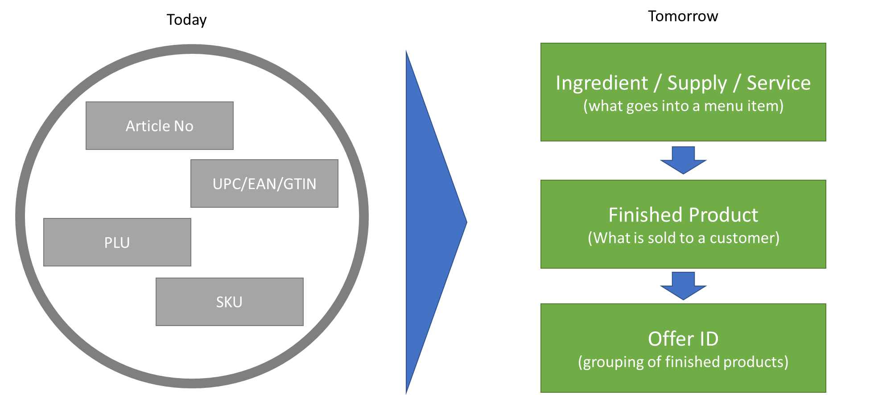
New Article Data Lexicon

Slide 14
Wawa Operations Engineering Study

Slide 15
New KPS Rules (Ops DOSO)

